Slide 1
Cinema-Goers
João Soares (93078) & Pedro Silva (93011)
Master in Informatics Engineering
10/01/2022

Slide 2
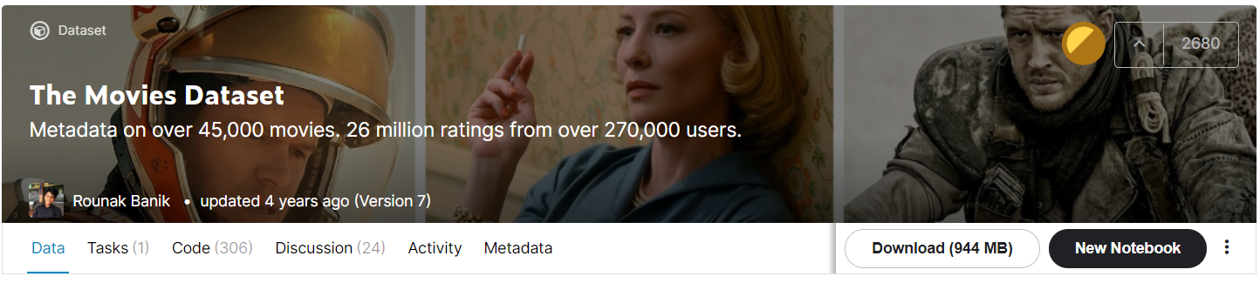
Data Analysis
We used the dataset : The Movies Dataset that contains information on 45,000 movies featured in the Full MovieLens dataset.
We only considered those with a budget higher than 0 ( 8903 movies ).
The dataset contains numerous movie-related metadata, among which we use:
Budget
Genres
Original Language
Spoken Languages
Title
Overview
Popularity
Production Companies
Production Countries
Release Date
Revenue
Director (throw the Cast data)

Slide 3
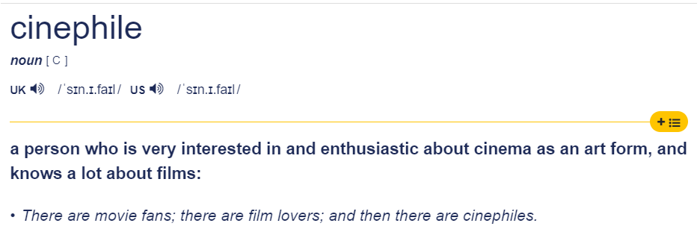
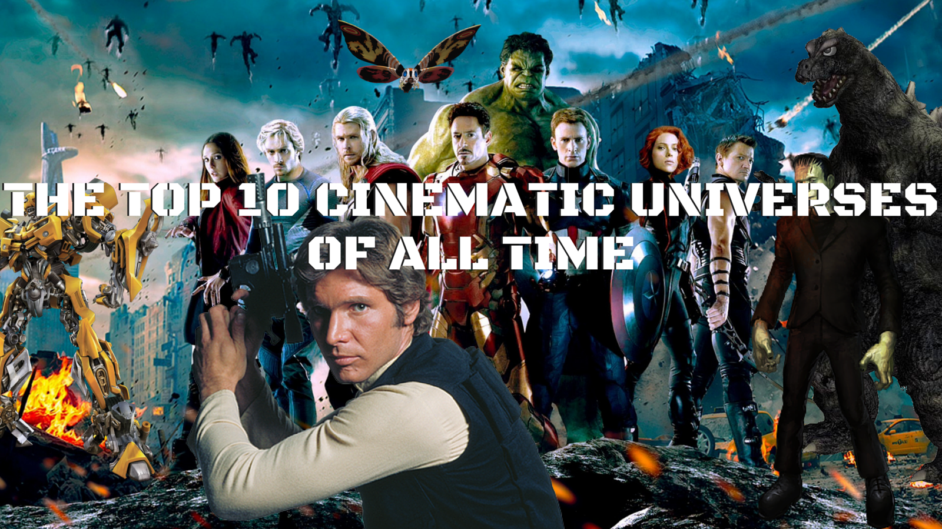
Users and Context of Utilization
In an era in which more and more movies are released and are increasingly easy to access and “cinematic universes” are created, we believe that the application will have a wide range of users.
The users in mind for the application could be normal people curious about movies that occasionally want to know details about a certain movie.
But we expect that the main users of the application will consist of Cinephiles.

Slide 4

Main Questions
Most popular movies?
Where are movies produced?
What is the most spoken language in movies?
Is there any relationship between budget and popularity?
In which movies Production Companies worked together to make it?
Production Companies that produced the most movies on a certain year?
Relation of film language and revenue obtained?
Director speciality regarding the gender of the movies?
What are the great centers of cinema and how have they changed over time?

Slide 5






Visualization Techniques
The following visualization techniques were chosen taking into consideration first its functional factor and then its visual and appealing factor:
Choropleth Map
Treemap
Stacked area chart
Spider chart
Scatterplot
Network graph

Slide 6
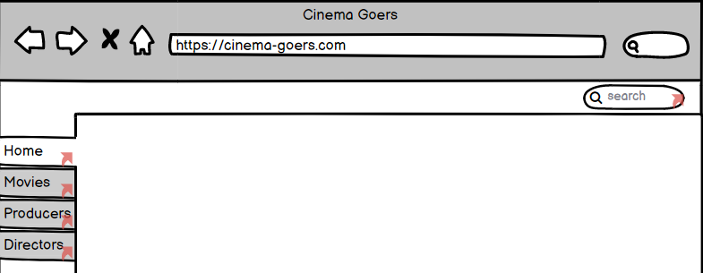
Low Fidelity Prototype - User FeedBack
Compress more information and visualization options in the different views to reduce the number of them.
Instead of having a simple Treemap, we could implement something of a Hierarchical Treemap , thus benefiting from a greater clarity in the data visualization.

Slide 7
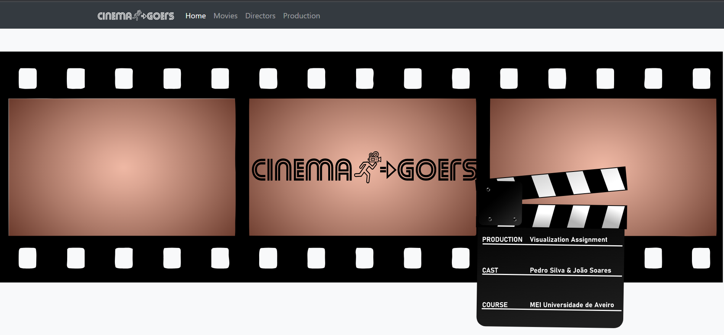
Prototype
https://cinema-goers.netlify.app/

Slide 8
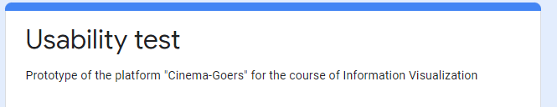
Usability Test
10 sets of questions to be answered using the prototype.
A set of questions to collect data about the profile of the user.
A set of questions about the experience with the prototype.
Opinion on the prototype through a standard usability questionnaire (SUS- System Usability Scale).

Slide 9
Usability Test - Results
Overall good results with the participants being able to use the prototype throughout the Usability Test and answering correctly to the set of questions.
Some of the most common indications provided by the users were added to the prototype previously presented:
Add an indication of “what color is the director” when comparing the genres of a Director in the SpiderChart Graph.
Add an indication of what color corresponded to what language/studio and make the scale end in 2020 in the Stack Area Chart.
In the Tree Map scaled the “rectangles” to improve the visualization, improved the “Go Back” button and added a tooltip to make it clear to the user, that to filter by language the user had to click in the “rectangle” of the language.
Add hover effects to improve, (and help to distinct), the visualization of the movies made by a production company and tooltips throwout the Network Graph to make it easier to know how many movies a production company produced.

Slide 10
Future Work
Possibility to select different range of years in the Choropleth Map, not just decades.
Filter by more than one Production Company in the Scatterplot Visualization.
In the SpiderChart add the option of suggestive Search rather than the select options.
To avoid performance issues in the Network Graph when searching for large movie companies will add the option to only render a certain amount of items indicated by the user.

